Slide 1
STI 2018
HIV/STIs in Transgender Populations
Social, Structural, Behavioural, and Biological Factors Driving STI Epidemics
Tonia Poteat, PhD, MPH, PA-C
21 July 2018

Slide 2

Disclosure
Relations that could be relevant for the meeting | Company names
Sponsorship or refund funds | None
Payment or other financial remuneration | None
Shareholder rights | None
Research support | Gilead Sciences Viiv Healthcare

Slide 3
Acknowledgements
Thank you to the transgender people and people living with HIV who have generously shared their time, experiences, and bodies for the purposes of research.
This research and our fight against HIV is indebted to those past and present who put themselves forward.

Slide 4
Road Map
Brief terminology overview
HIV/STI epidemiologic data update
Multi-level drivers of HIV/STI
Integration of conceptual frameworks
Future pathways

Slide 5
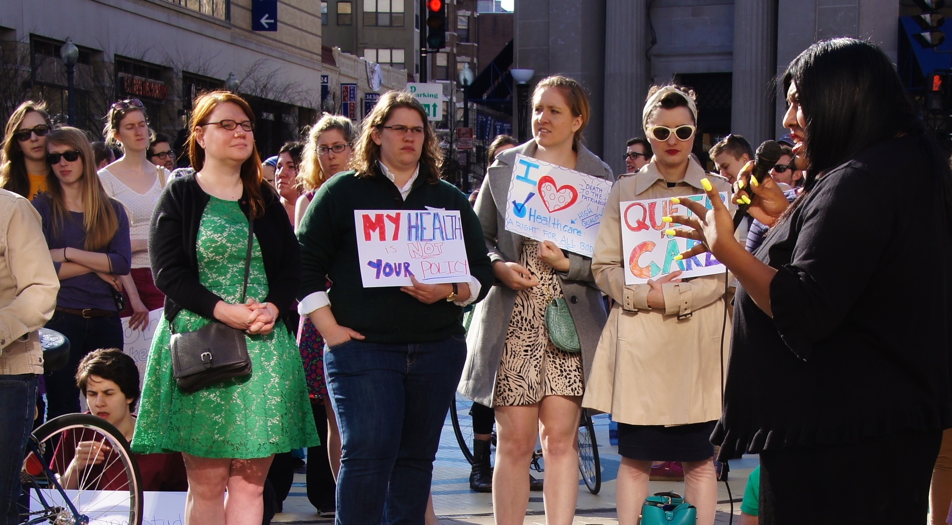
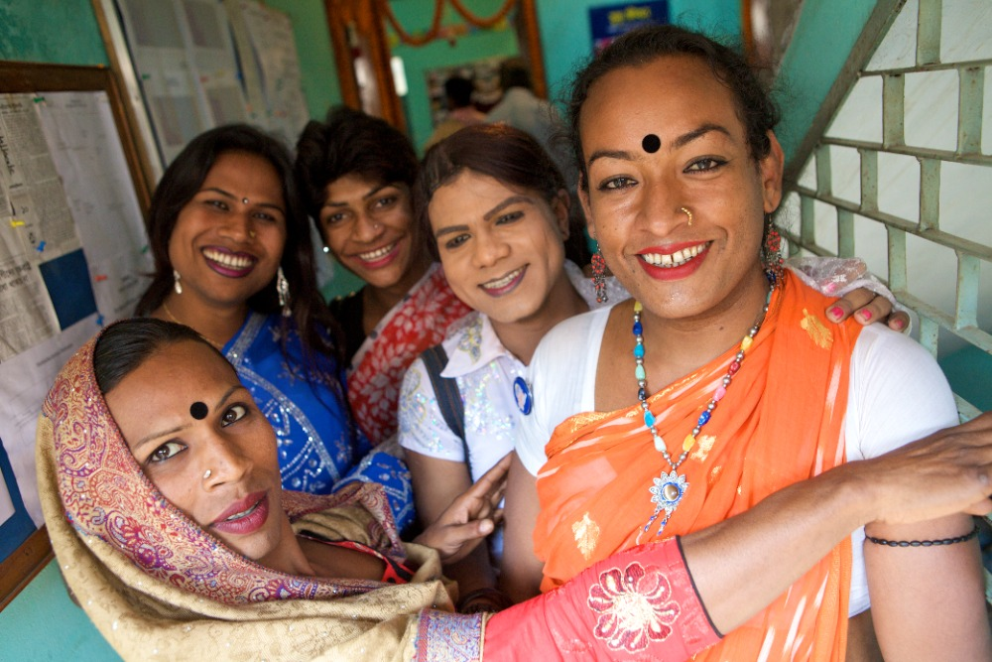
Terminology
Cisgender (cis): gender = sex assigned at birth (SAB)
Transgender (trans): gender differs from SAB
    Trans feminine: male SAB, identify along female spectrum (e.g., women, trans women, hijra, kathoey, travestis, waria)¹
    Trans masculine: female SAB, identify along male spectrum (e.g., men, trans men, stud, tom, Sadhin)¹
    Non-binary: identity neither male OR female, or a combination (eg. genderqueer, gender fluid, agender)

Slide 6
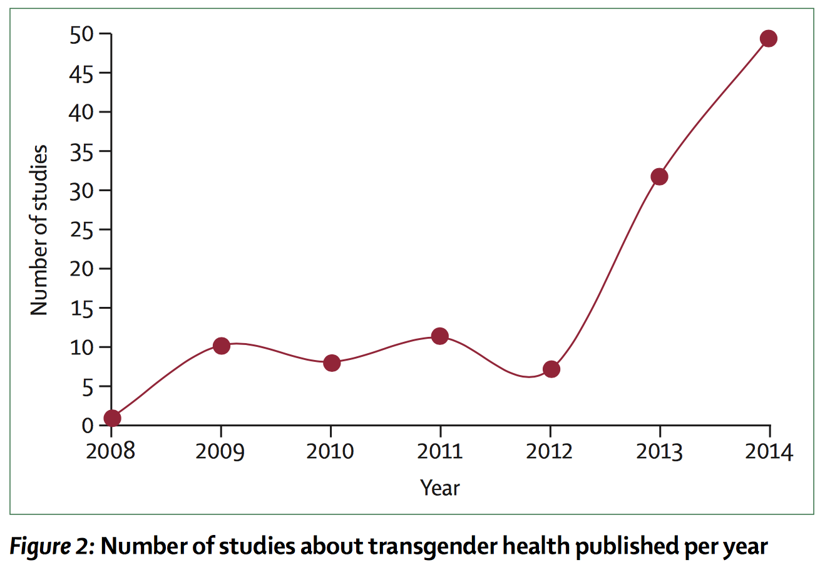
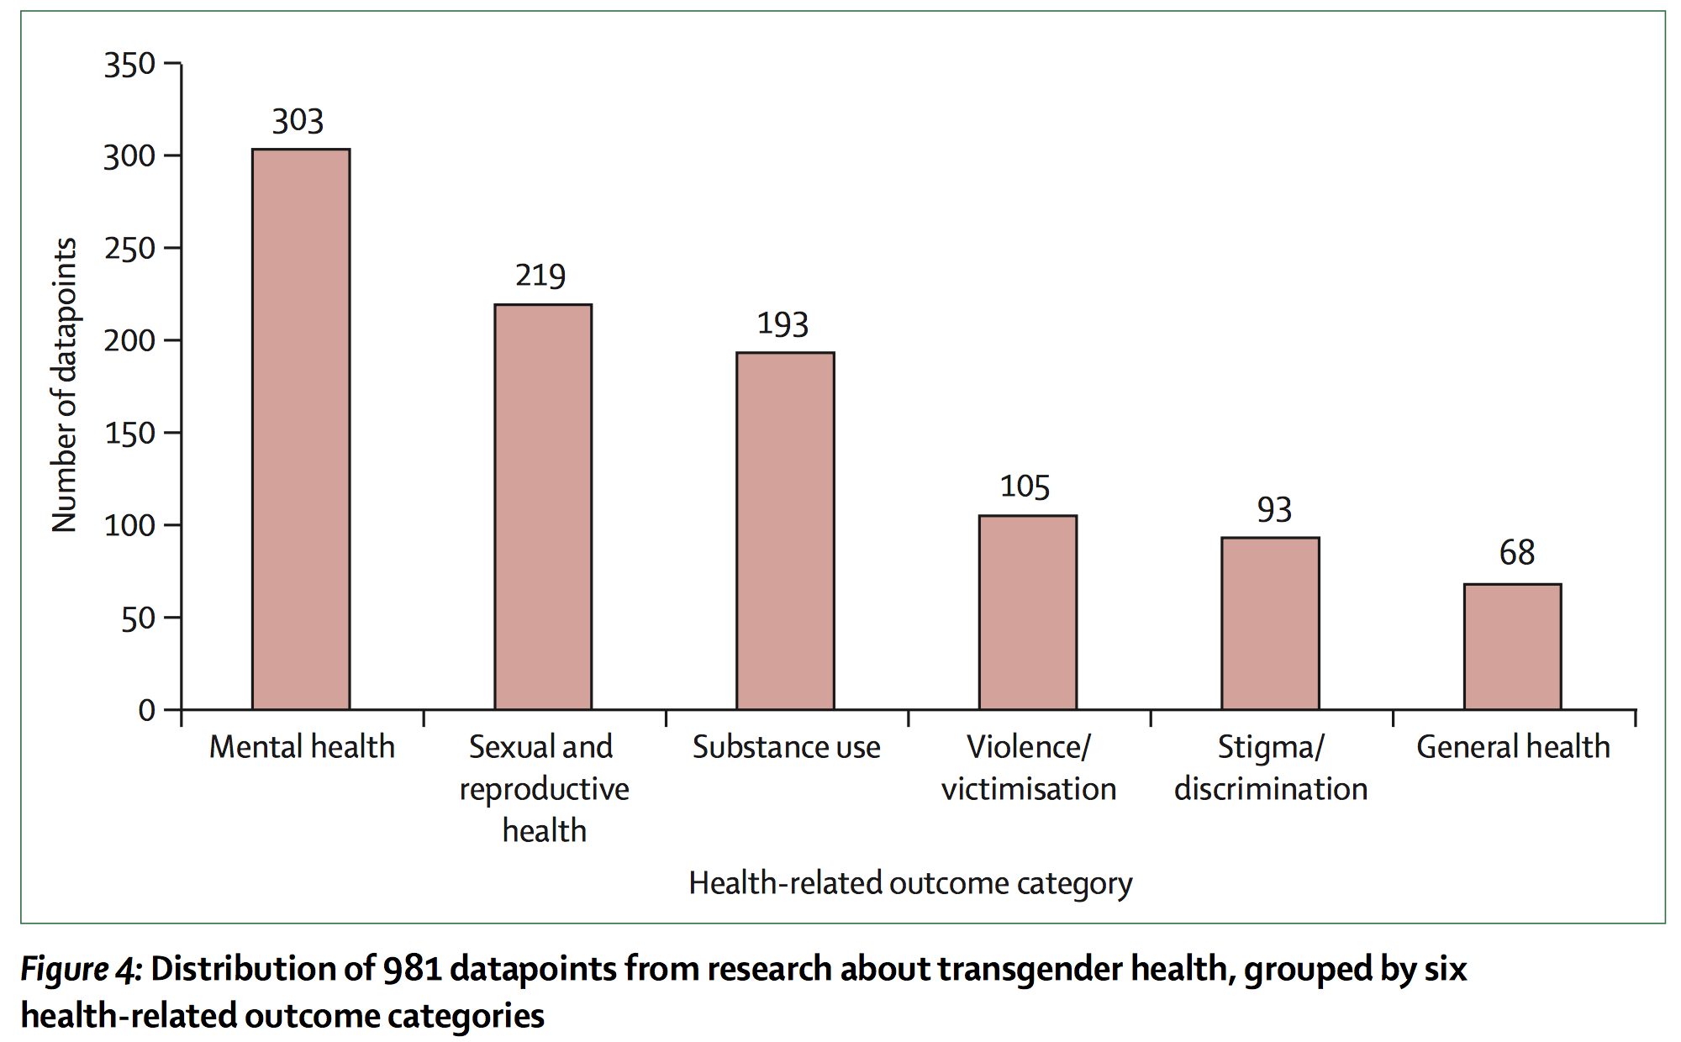
Growing Data on Transgender Health
Figures from Reisner et al. 2016
Exponential increase in transgender health research in recent years
Sexual health is second most common area of research focus
    Mostly HIV and STIs
    Vast majority of data on transgender people assigned male sex at birth

Slide 7
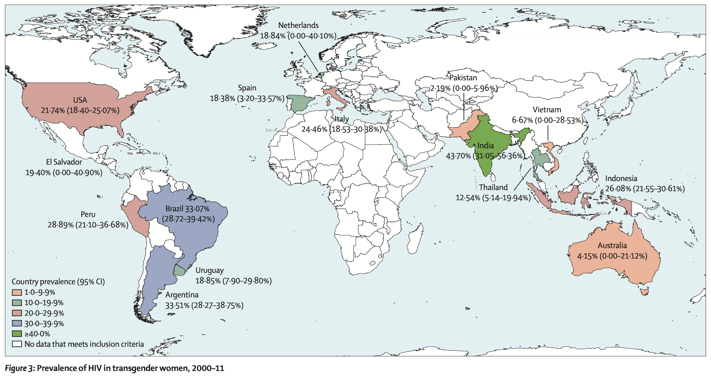
HIV Burden: Trans Women (TW)
HIV global meta-analysis (2000-11):² 15 countries, >11,000 TW
  Pooled prevalence 19%, OR 49 v. repro aged adults (lab confirmed)
  No data from sub-Saharan Africa or Central Asia/Eastern Europe
HIV systematic review (2012-15):³ Self-report and lab confirmed
  50 new studies published, most among TW outside the U.S.
  Highest prevalence among youth and women of color
  3 incidence estimates: 1.2-3.6 per 100 person-years
  Only 8 studies on syndemic drivers. Still no data from SSA or CA/EU.
    In parts of the world where HIV burden is greatest, we have the least amount of information about transgender populations
?

Slide 8
HIV Prevalence in TW in Sub-Saharan Africa⁵
“MSM” studies at 14 sites across 8 countries: Burkina Faso, Cote d’Ivoire, The Gambia, Lesotho, Malawi, Senegal, Swaziland, and Togo
        RDS/PLACE ⇒ Survey ⇒ rapid HIV testing
        Among 4,586 male SAB participants, 20% identified as TW or female (remaining were cis MSM) ⇒ 937 TW
        HIV prevalence among TW: 25% (vs. 14% among cis MSM)
    Violence, law enforcement stigma, and depression significantly associated with HIV
Poteat et al. 2017

Slide 9
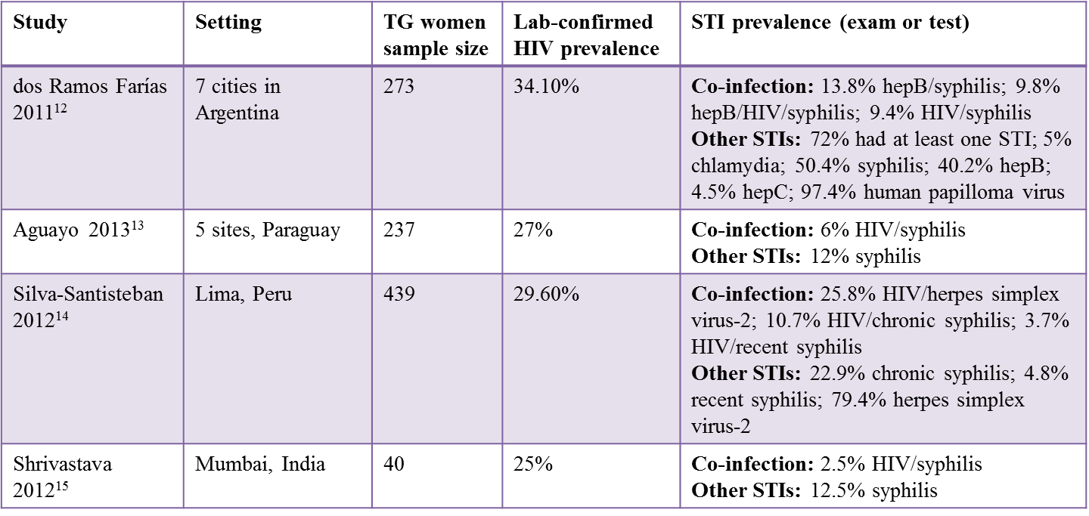
STI Burden: Trans Women (TW)
HIV/STI co-infection systematic review (2010-15):⁶ 27 studies
  High prevalence of STIs in all studies
  Only 4 studies addressed HIV/STI co-infection, all in TW outside US
    STI co-infections range from 2.5% to 13.8%
2017 data with Baltimore-based TW sex workers (n=63)
  44% tested positive for STI (GC/CT/Trich) and 41% HIV+
MacCarthy et al. 2017

Slide 10
HIV/STI Burden: Trans Men (TM)
HIV systematic review (2012-15):³ 11 studies included TM
  6 USA studies: 1 self-report (0.4%), 5 lab tested (0.5%-4.3%)
  5 non-USA studies: 3 self-report (0.6%-8.0%), 2 lab tested (0.0%-2.2%)
  Higher prevalence in clinic samples and those with smaller sample sizes
  HIV risk among TM who have sex with cisgender men (TMSM)
HIV/STI co-infection systematic review (2010-15):⁶ 5 studies of TM
  1 global study: Spain, Portugal, Latin America, and Caribbean:⁷
    8% HIV+; 3.9% GC (0.0% chlamydia, 0.0% syphilis): self-report
  4 US studies from urban centers in California or Massachusetts:⁸⁻¹¹
    HIV prevalence ranged from 0.0%-10.1%
    Widely varied rates of STIs and small sample sizes (N=16-82)
      Highest self-report: 81% ever had an STI (N=16 venue based sampling)
      Highest lab-tested: 11.1% rectal chlamydia (N=69, retrospective chart)
Notes:
MAKE THESE INTO CHARTS!!!!

Slide 11
HIV/STI Burden: Non-binary (NB) People
US Transgender Survey (N=27,715):⁴
  35% of respondents were NB (n=9,700)
  Self-reported NB HIV prevalence (overall): 0.4%
    Among female SAB: 0.2%
    Among male SAB: 1.0%
NO studies identified with STI data on NB individuals

Slide 12
Multilevel Drivers of HIV and STI Risk among Transgender Populations
Structural (e.g., lack of legal protections, discriminatory laws and policies)
Community (e.g., stigma, social exclusion, violence)
Network (e.g., high prevalence partners, high risk sex work environments)
Biological (e.g., anal sex, vaginal atrophy)
Figure from Poteat et al. 2016
Notes:
Vaginal atrophy=hormone mediated atrophy of vaginal tissue among trans masculine MSM taking testosterone

Slide 13
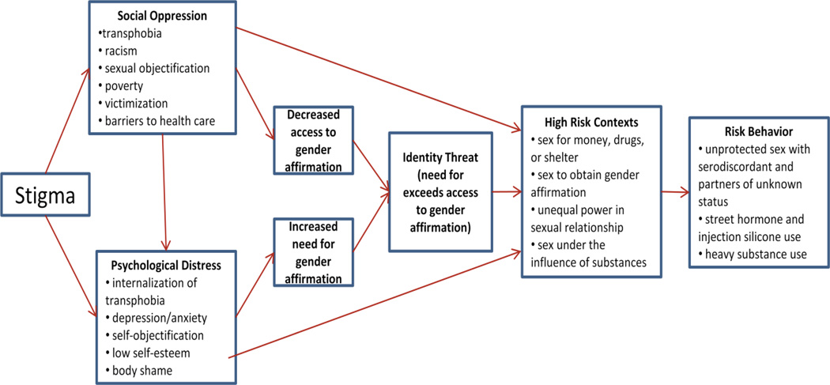
Multilevel Drivers of HIV and STI Risk among Transgender Populations:
Gender Affirmation Framework¹⁶
Structural
Individual
Individual Interpersonal
Community
Individual
Individual
Figure from Sevelius 2013

Slide 14
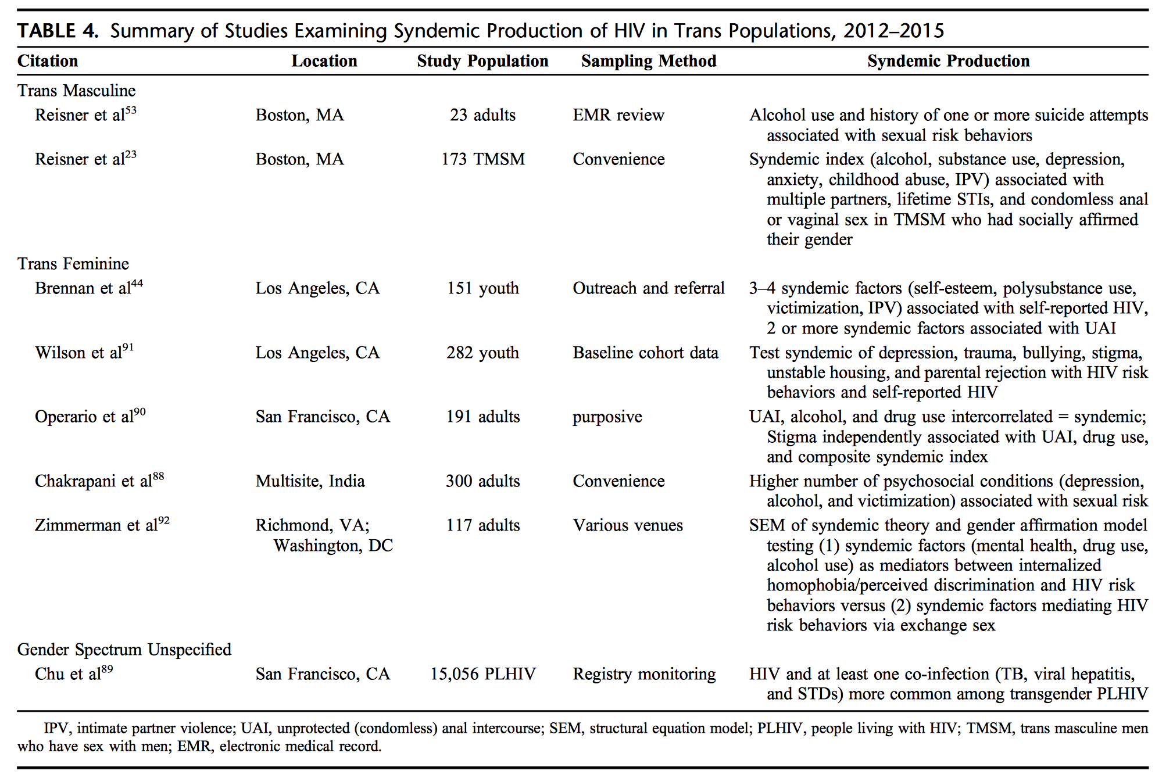
Studies Examining Syndemic Production in Transgender Populations
    Greater focus on individual behaviors versus outcomes of structural and community-level factors
Poteat et al. 2016
Notes:
Vaginal atrophy=hormone mediated atrophy of vaginal tissue among trans masculine MSM taking testosterone

Slide 15
Integrating Syndemics and Gender Affirmation Theories: An Example
Study examined role of syndemic conditions and social gender affirmation processes (living full-time in one’s identified gender) in potentiating sexual risk among TMSM adults (n=173) in Massachusetts¹⁷
Syndemic: 6 indicators summed (binge drinking, substance use, depression, anxiety, childhood abuse, intimate partner violence)
Syndemics were associated with increased odds of all sexual risk indicators (aOR=1.32-1.55; p<0.0001)
Social gender affirmation moderated the association between syndemics and condomless anal/vaginal sex at last encounter with a cis male. (p<0.0001)
Syndemics were associated with sexual risk in TMSM who had socially affirmed their gender (aOR=1.79; 95% CI=1.42-2.25; p<0.001), but not among those TMSM who had not (aOR=0.86; 95% CI=0.63-1.19; p=0.37).
Notes:
Sexual risk outcomes: lifetime STI diagnosis, 3 or more past-6-month sexual partners, and condomless anal/vaginal sex at last encounter with a cis male
Findings suggest that syndemic pathways to sexual risk are similar for TMSM who have socially gender affirmed as for cisgender MSM. Integration of syndemics and gender affirmation frameworks is recommended in interventions to address TMSM sexual risk.
Other info from discussion of paper:
This finding suggests that sexual health research and programming seeking to reach at-risk TMSM remain inclusive and promote diversity, not limit trans masculine samples to individuals who have affirmed their gender in any particular way. In this sample, TMSM who had not socially transitioned were younger age and more likely to report a genderqueer/gender variant/or gender nonconforming gender identity – these individuals were engaging in the highest current sexual risk behaviours.

Slide 16
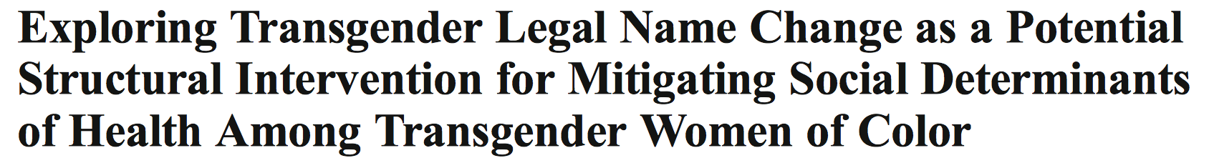

Evidence-based Interventions Tailored for Transgender People are Limited
Few evidence-based HIV/STI prevention interventions have been tested among transgender populations¹⁸
  Most target behavior change and/or biomedical interventions among TW (e.g., condom use, HIV knowledge, PrEP uptake)
  Evidence-based multi-level and structural interventions needed
TW initiating legal name change (n=37) compared with TW who completed name change > 9 months prior (n=28)¹⁹
Pre-name change group more likely to report postponing medical care due to gender identity, non-prescribed injection hormone use, and experiencing verbal harassment
Post-name change group significantly more likely to have a higher monthly income and stable housing
Notes:
Only one HIV prevention program evaluated with TG men
Abstract
The purpose of this exploratory study was to examine the effects of legal name change on socioeconomic factors, general and transgender-related health care access and utilization, and transgender-related victimization in a sample of young transgender women (transwomen) of color. A cross-sectional group comparison approach was used to assess the potential effects of legal name change. A convenience sample of young transwomen enrolled in a no-cost legal name change clinic were recruited to complete a 30-min interviewer-guided telephone survey including sociodemographic and socioeconomic factors, health and well-being, health care utilization, transgender transition-related health care, and transgender-related victimization. Sixty-five transgender women of color (37 = pre-name change group, 28 = post-name change group) completed the survey. Results indicated that the transwomen in the post-name change group were significantly older than the pre-name change group. In age-adjusted analyses, the post-name change group was significantly more likely to have a higher monthly income and stable housing than the pre-name change group. No significant differences were observed for general health care utilization; however, a significantly greater percentage of transwomen in the pre-name change group reported postponing medical care due to their gender identity. In addition, a significantly larger proportion of transwomen in the pre-name change group reported using non-prescribed hormones injected by friends and experiencing verbal harassment by family and friends compared to transwomen in the post-name change group. Findings suggest that legal name change may be an important structural intervention for low-income transwomen of color, providing increased socioeconomic stability and improved access to primary and transition-related health care
Point to make: intervention not directly related to HIV or STIs, reaching across syndemic
Findings (from abstract): In age-adjusted analyses, the post-name change group was significantly more likely to have a higher monthly income and stable housing than the pre-name change group. No significant differences were observed for general health care utilization; however, a significantly greater percentage of transwomen in the pre-name change group reported postponing medical care due to their gender identity. In addition, a significantly larger proportion of transwomen in the pre-name change group reported using non-prescribed hormones injected by friends and experiencing verbal harassment by family and friends compared to transwomen in the post-name change group. Findings suggest that legal name change may be an important structural intervention for low-income transwomen of color, providing increased socioeconomic stability and improved access to primary and transition-related health care.

Slide 17
Promising Future Pathways
More and better quality data on HIV/STIs among transgender people
Disaggregated data from transgender participants included within research on broader or different populations (eg. MSM or FSWs)
Inclusion of data on anatomical configuration of transgender research participants (i.e., for the purposes of understanding HIV and STI risk) through meaningful collaboration with transgender communities
Research on drug-interactions with gender-affirming hormones
Testing interventions that combine gender affirmation with other HIV/STI prevention strategies
Structural intervention opportunities (e.g., non-discrimination laws, transgender-specific housing programs, etc.) to target syndemic impacts of co-occurring multilevel drivers of HIV/STI risk

Slide 18
Works Cited
¹Reisner, S. L., Poteat, T., Keatley, J., Cabral, M., Mothopeng, T., Dunham, E., ... & Baral, S. D. (2016). Global health burden and needs of transgender populations: a review. The Lancet, 388(10042), 412-436.
²Baral, S. D., Poteat, T., Strömdahl, S., Wirtz, A. L., Guadamuz, T. E., & Beyrer, C. (2013). Worldwide burden of HIV in transgender women: a systematic review and meta-analysis. The Lancet infectious diseases, 13(3), 214-222.
³Poteat, T., Scheim, A., Xavier, J., Reisner, S., & Baral, S. (2016). Global epidemiology of HIV infection and related syndemics affecting transgender people. Journal of acquired immune deficiency syndromes (1999), 72(Suppl 3), S210.
⁴James, S. E., Herman, J. L., Rankin, S., Keisling, M., Mottet, L., & Anafi, M. (2016). The Report of the 2015 U.S. Transgender Survey. Washington, DC: National Center for Transgender Equality.
⁵Poteat, T., Ackerman, B., Diouf, D., Ceesay, N., Mothopeng, T., Odette, K. Z., ... & Mnisi, Z. (2017). HIV prevalence and behavioral and psychosocial factors among transgender women and cisgender men who have sex with men in 8 African countries: A cross-sectional analysis. PLoS medicine, 14(11), e1002422.
⁶MacCarthy, S., Poteat, T., Xia, Z., Roque, N. L., Baral, S., & Reisner, S. L. (2017). Current research gaps: a global systematic review of HIV and sexually transmissible infections among transgender populations. Sexual health, 14(5), 456-468.
⁷Reisner SL, Biello K, Rosenberger JG, Austin SB, Haneuse S, Perez-Brumer A, et al. Using a two-step method to measure transgender identity in Latin America/the Caribbean, Portugal, and Spain. Arch Sex Behav 2014; 43(8): 1503–14. doi:10.1007/s10508-014-0314-2
⁸Stephens SC, Bernstein KT, Philip SS. Male to female and female to male transgender persons have different sexual risk behaviors yet similar rates of STDs and HIV. AIDS and Behavior 2011; 15(3):683–6. doi:10.1007/s10461-010-9773-1
⁹Green N, Hoenigl M, Morris S, Little SJ. Risk behavior and sexually. transmitted infections among transgender women and men undergoing community-based screening for acute and early HIV infection in San Diego. Medicine (Baltimore) 2015; 94(41): e1830. doi:10.1097/ MD.0000000000001830
¹⁰Reisner SL, Perkovich B, Mimiaga MJ. A mixed methods study of the. sexual health needs of New England transmen who have sex with nontransgender men. AIDS Patient Care STDS 2010; 24(8): 501–13. doi:10.1089/apc.2010.005911
¹¹Reisner SL, White Hughto JM, Pardee D, Sevelius J. Syndemics and gender affirmation: HIV sexual risk in female-to-male trans masculine adults reporting sexual contact with cisgender males. International Journal of STD & AIDS 2016; 27(11): 955–66.
¹²dos Ramos Farías MS, Garcia MN, Reynaga E, Romero M, Vaulet ML, Fermepin MR, et al. First report on sexually transmitted infections among trans (male to female transvestites, transsexuals, or transgender) and male sex workers in Argentina: high HIV, HPV, HBV, and syphilis prevalence. Int J Infect Dis 2011; 15(9): e635–40.
¹³Aguayo N, Munoz SR, Aguilar G. P3.35 HIV and SYPHILIS prevalence and behaviour, practises and attitudes of the TRANS population in Paraguay, 2011. Sex Transm Infect 2013; 89: A254.
¹⁴Silva-Santisteban A, Raymond HF, Salazar X, Villayzan J, Leon S, McFarland W, et al. Understanding the HIV/AIDS epidemic in transgender women of Lima, Peru: results from a sero-epidemiologic study using respondent driven sampling. AIDS and Behavior 2012; 16(4): 872–81.
¹⁵Shrivastava SR, Bobhate PS. Prevalence of HIV and syphilis in patients attending sexually transmitted infections (STI) clinic in an Urban Slum. J Res Health Sci 2012; 12(1): 7–14.
¹⁶Sevelius, J. M. (2013). Gender affirmation: a framework for conceptualizing risk behavior among transgender women of color. Sex roles, 68(11-12), 675-689.
¹⁷Reisner, S. L., White Hughto, J. M., Pardee, D., & Sevelius, J. (2016). Syndemics and gender affirmation: HIV sexual risk in female-to-male trans masculine adults reporting sexual contact with cisgender males. International journal of STD & AIDS, 27(11), 955-966.
¹⁸Poteat, T., Malik, M., Scheim, A., & Elliott, A. (2017). HIV prevention among transgender populations: Knowledge gaps and evidence for action. Current HIV/AIDS Reports, 14(4), 141-152.
¹⁹Hill BJ, Crosby R, Bouris A, Brown R, Bak T, Rosentel K, et al. Exploring transgender legal name change as a potential structural intervention for mitigating social determinants of health among transgender women of color. Sex Res Soc Pol. 2017:1–9.

